Slide 1





Next Gen Employability Program
NEXT GEN EMPLOYABILITY PROGRAM
Creating a future-ready workforce
Team Members
College Name
Student Name : NAVENESVAR K
Student ID : au311121104040
LOYOLA-ICAM COLLEGE OF ENGINEERING AND TECHNOLOGY
Notes:
1

Slide 2

Next Gen Employability Program
CAPSTONE PROJECT SHOWCASE
Project Title
MUSIC WEB APPLICATION USING DJANGO FRAMEWORK
Abstract | Problem Statement | Project Overview | Proposed Solution | Technology Used | Modelling & Results | Conclusion

Slide 3
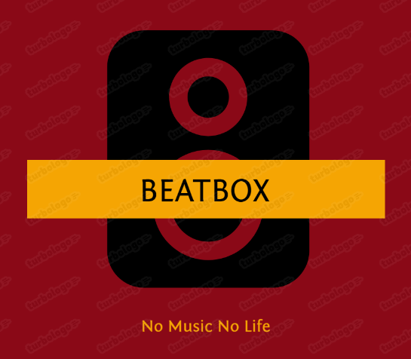
Next Gen Employability Program
Abstract
This project focuses on developing a music web application using the Django framework.
The objective is to provide music enthusiasts with a versatile platform for exploring, streaming, and organizing their favorite tracks.
By leveraging the robust features of Django, the project aims to create an intuitive and immersive user experience that redefines online music interaction.
Application Logo ----->
Source :
Project

Slide 4
Next Gen Employability Program
Problem Statement
With the increasing popularity of online streaming services, there is a growing demand for customizable music platforms tailored to individual preferences.
Users face challenges in discovering new music, organizing their tracks, and security.
This project aims to address these limitations by developing a comprehensive music web application using the Django framework.
The application will offer a wide range of functionalities, including User Authentication, My Channel, Listen Later, Listen History and Search Functionality.
Source :
Problem statement

Slide 5
Next Gen Employability Program
Project Overview
Key Components
User Authentication
Lister Later: Download song
My Channel : Music Upload
Search Functionality
Listen History
Expected Outcome : Timeline - 2 weeks
Upon completion, the project will deliver a fully functional music web application that provides users with a seamless and personalized music streaming experience.
Source :
Project Overview

Slide 6
Next Gen Employability Program
Proposed Solution
BeatBox is the name of my music web application . It is built using Django framework and aims to provide users with a
platform to listen to music
search for their favorite tracks
listen later their added tracks and can download the songs.
keep track of their listening history.
By leveraging Django's built-in features such as authentication and ORM, we can streamline user management and database operations, ensuring seamless interaction between users and the platform
On the frontend, employing a combination of HTML, CSS, JavaScript, and Bootstrap to create an engaging and responsive user interface, thereby enhancing the overall user experience
Source :
Project source

Slide 7
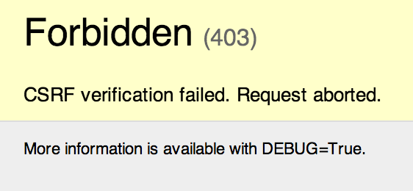
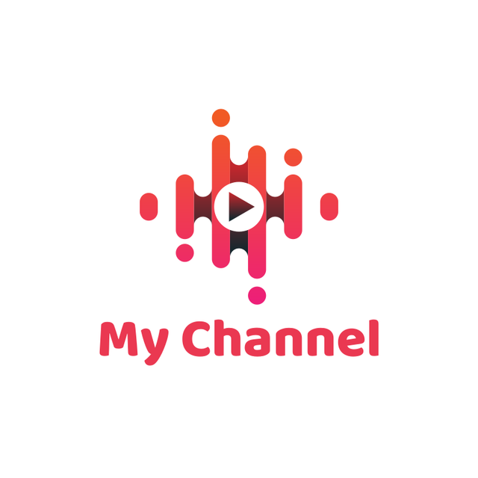
Next Gen Employability Program
Security
In BeatBox, user authentication and CSRF (Cross-Site Request Forgery) token are security measures implemented to ensure that users are who they claim to be and to prevent unauthorized access to web applications, respectively.
My Channel
Personalized channels allow users to curate their own playlists and share them with others. Users can upload their music to their channel.
Source :
Features

Slide 8
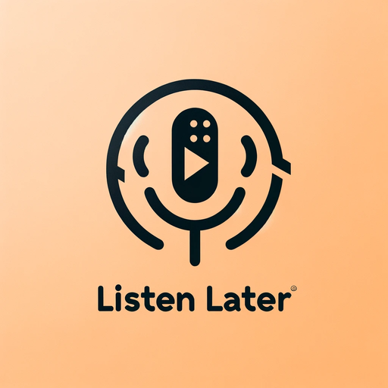
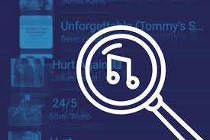

Next Gen Employability Program
Listen Later
Users can add tracks to their "Lister Later" playlist to listen to them at their convenience and can even download the songs.
Search Functionality
Robust search feature enables users to discover new music based on music title. The top search results will be displayed.
Listening History
Track listening history to revisit favorite songs and discover new ones based on past preferences.
Source :
Features

Slide 9
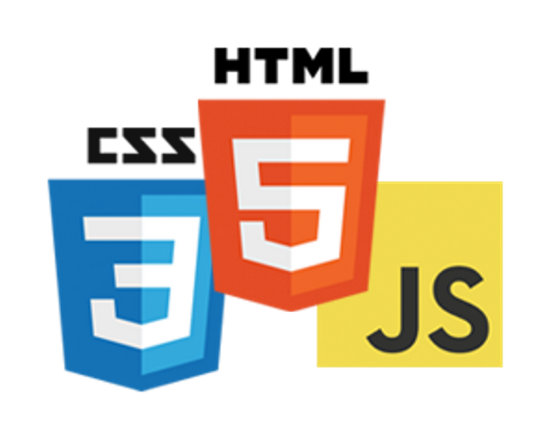
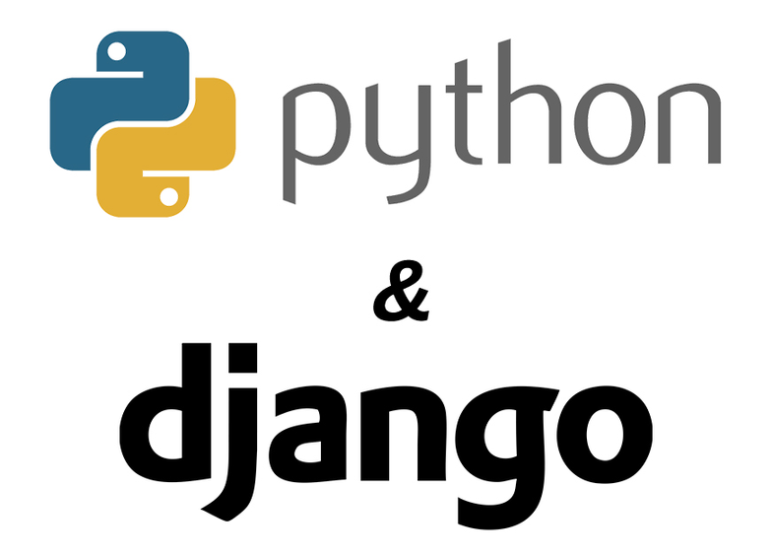
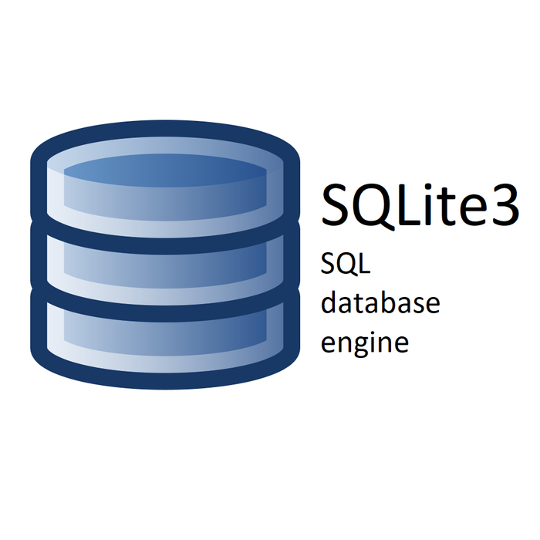
Next Gen Employability Program
Technology Used
Frontend
Backend
Database

Slide 10
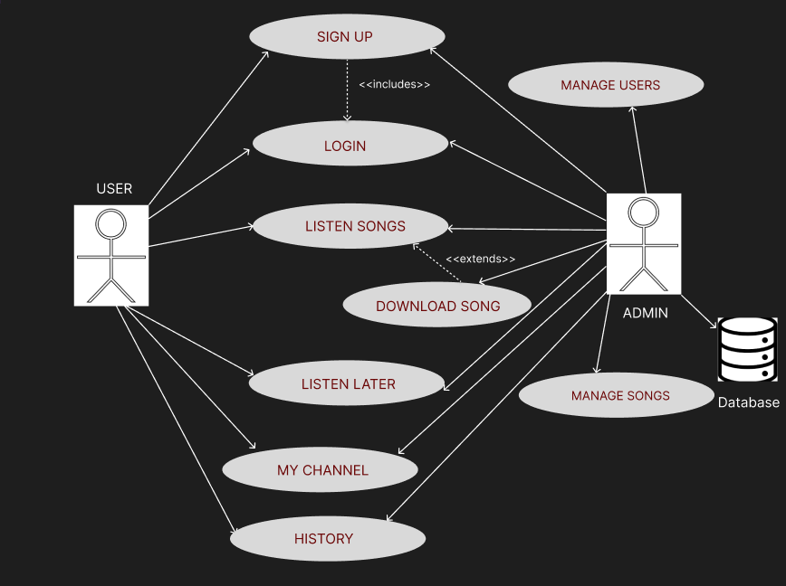
Next Gen Employability Program
Modelling & Results
USECASE DIAGRAM
The Use case diagram
for the music web
application
Source :
Model

Slide 11
Next Gen Employability Program
BEATBOX
NO MUSIC NO LIFE
Now, let us look at the various functionalities of BeatBox
For demostration, I have used Navenesvar_27 as the user account
Access the project source code and details at : Github

Slide 12
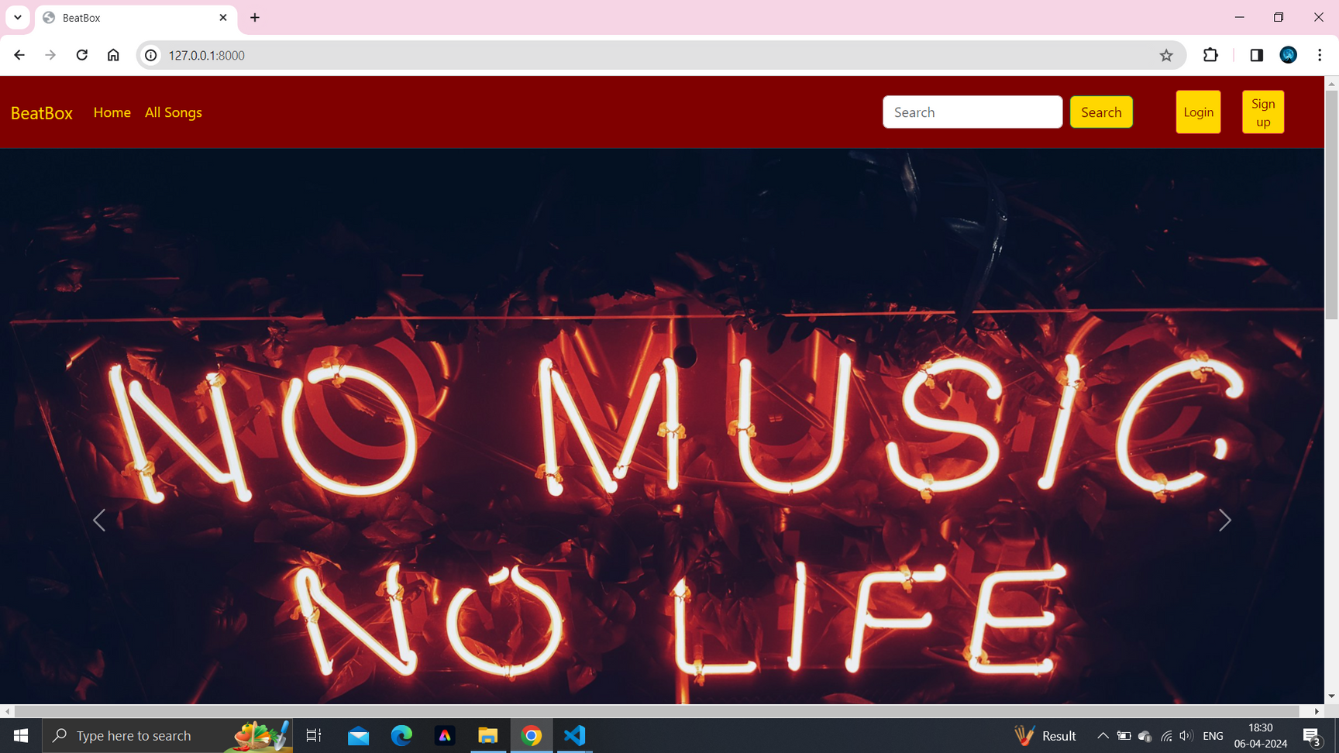
Next Gen Employability Program
Results
Homepage

Slide 13
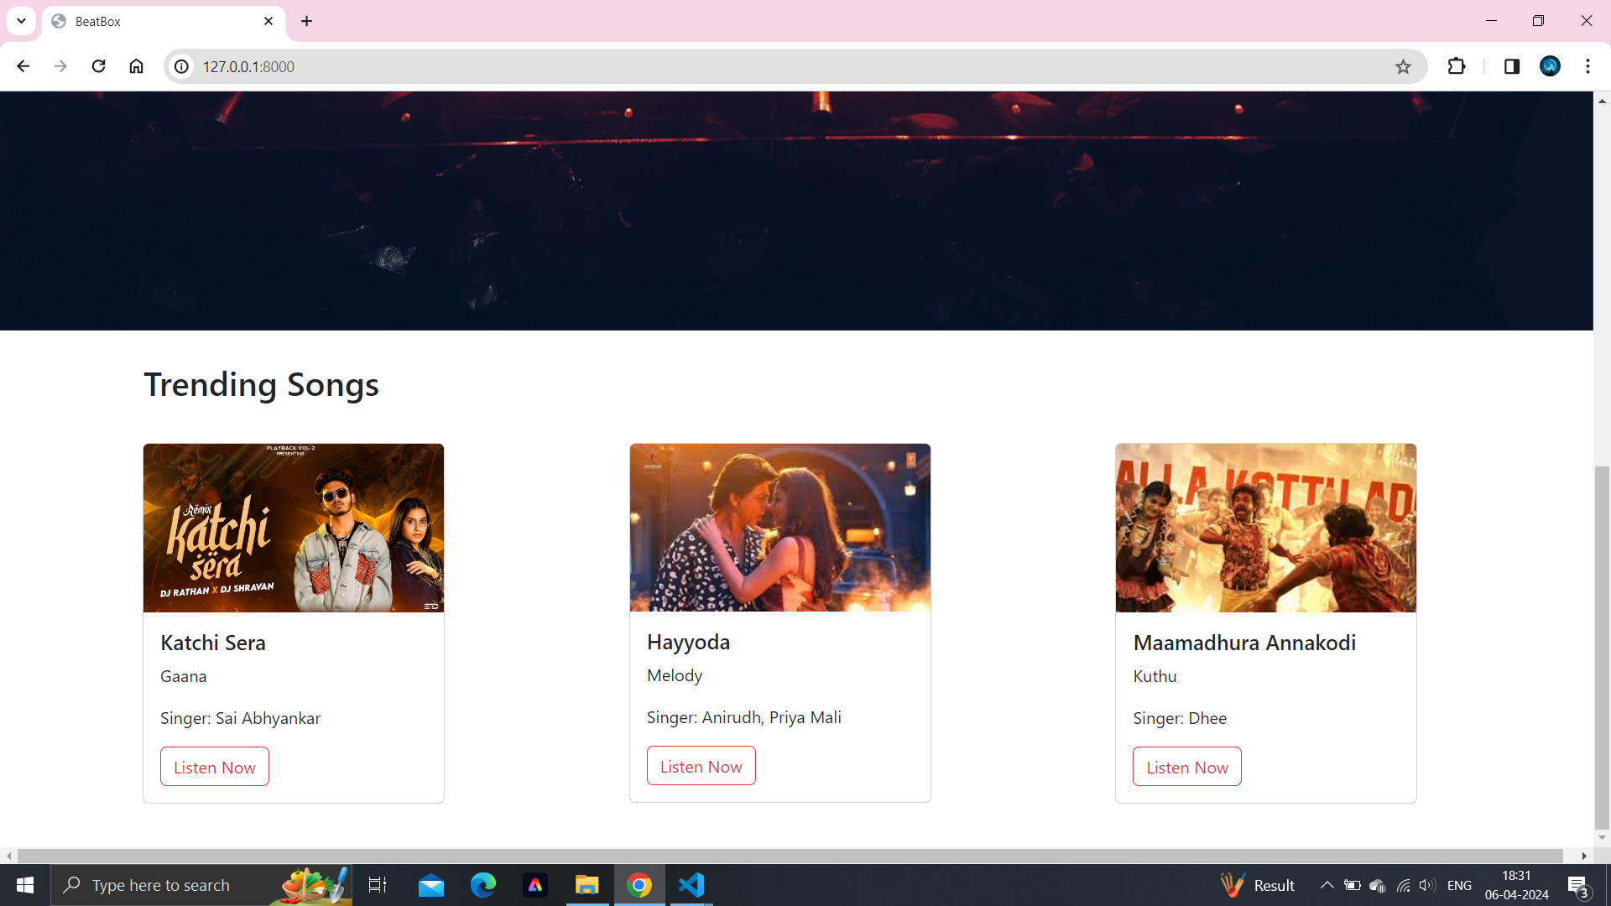
Next Gen Employability Program
Homepage

Slide 14
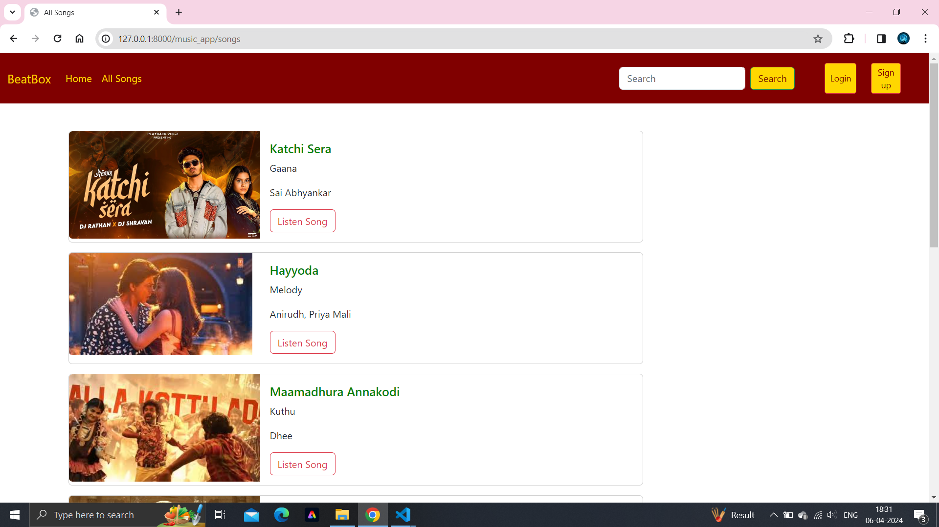
Next Gen Employability Program
All Songs Page

Slide 15
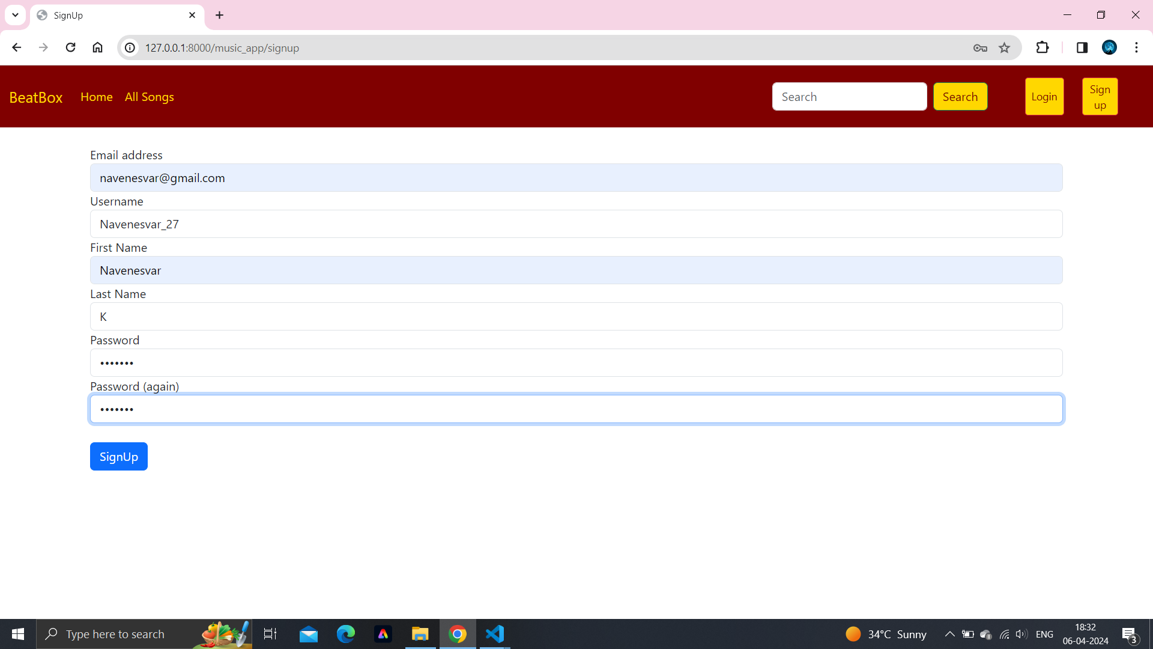
Next Gen Employability Program
Sign Up Page

Slide 16
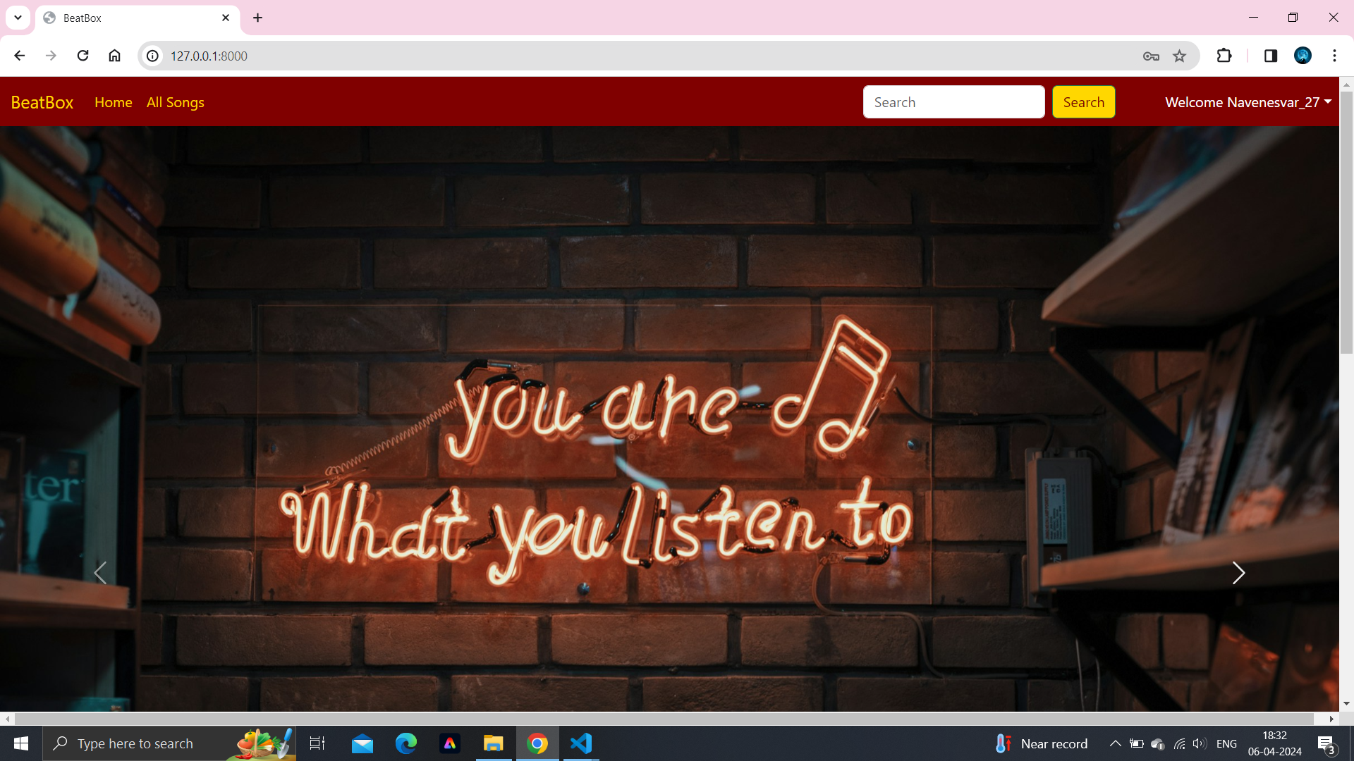
Next Gen Employability Program
Welcome Page

Slide 17
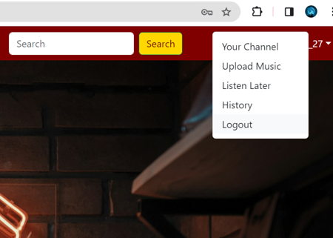
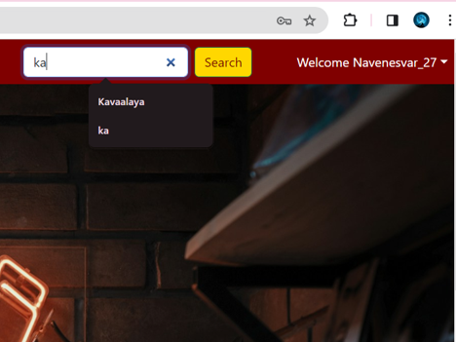
Next Gen Employability Program
List of Features
Search Functionality

Slide 18
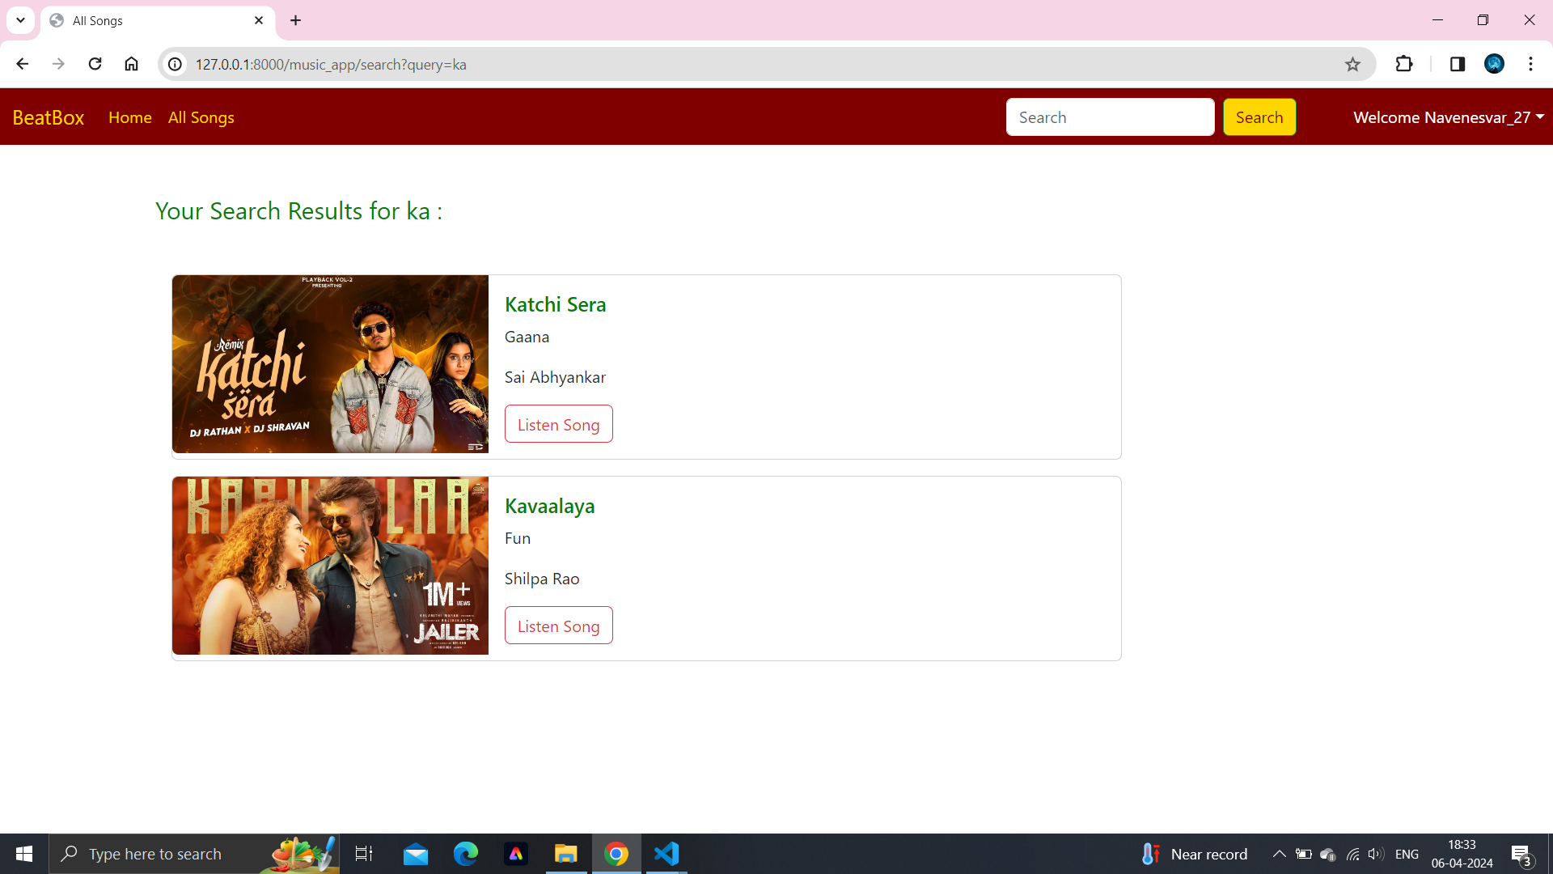
Next Gen Employability Program
Search Results Page

Slide 19
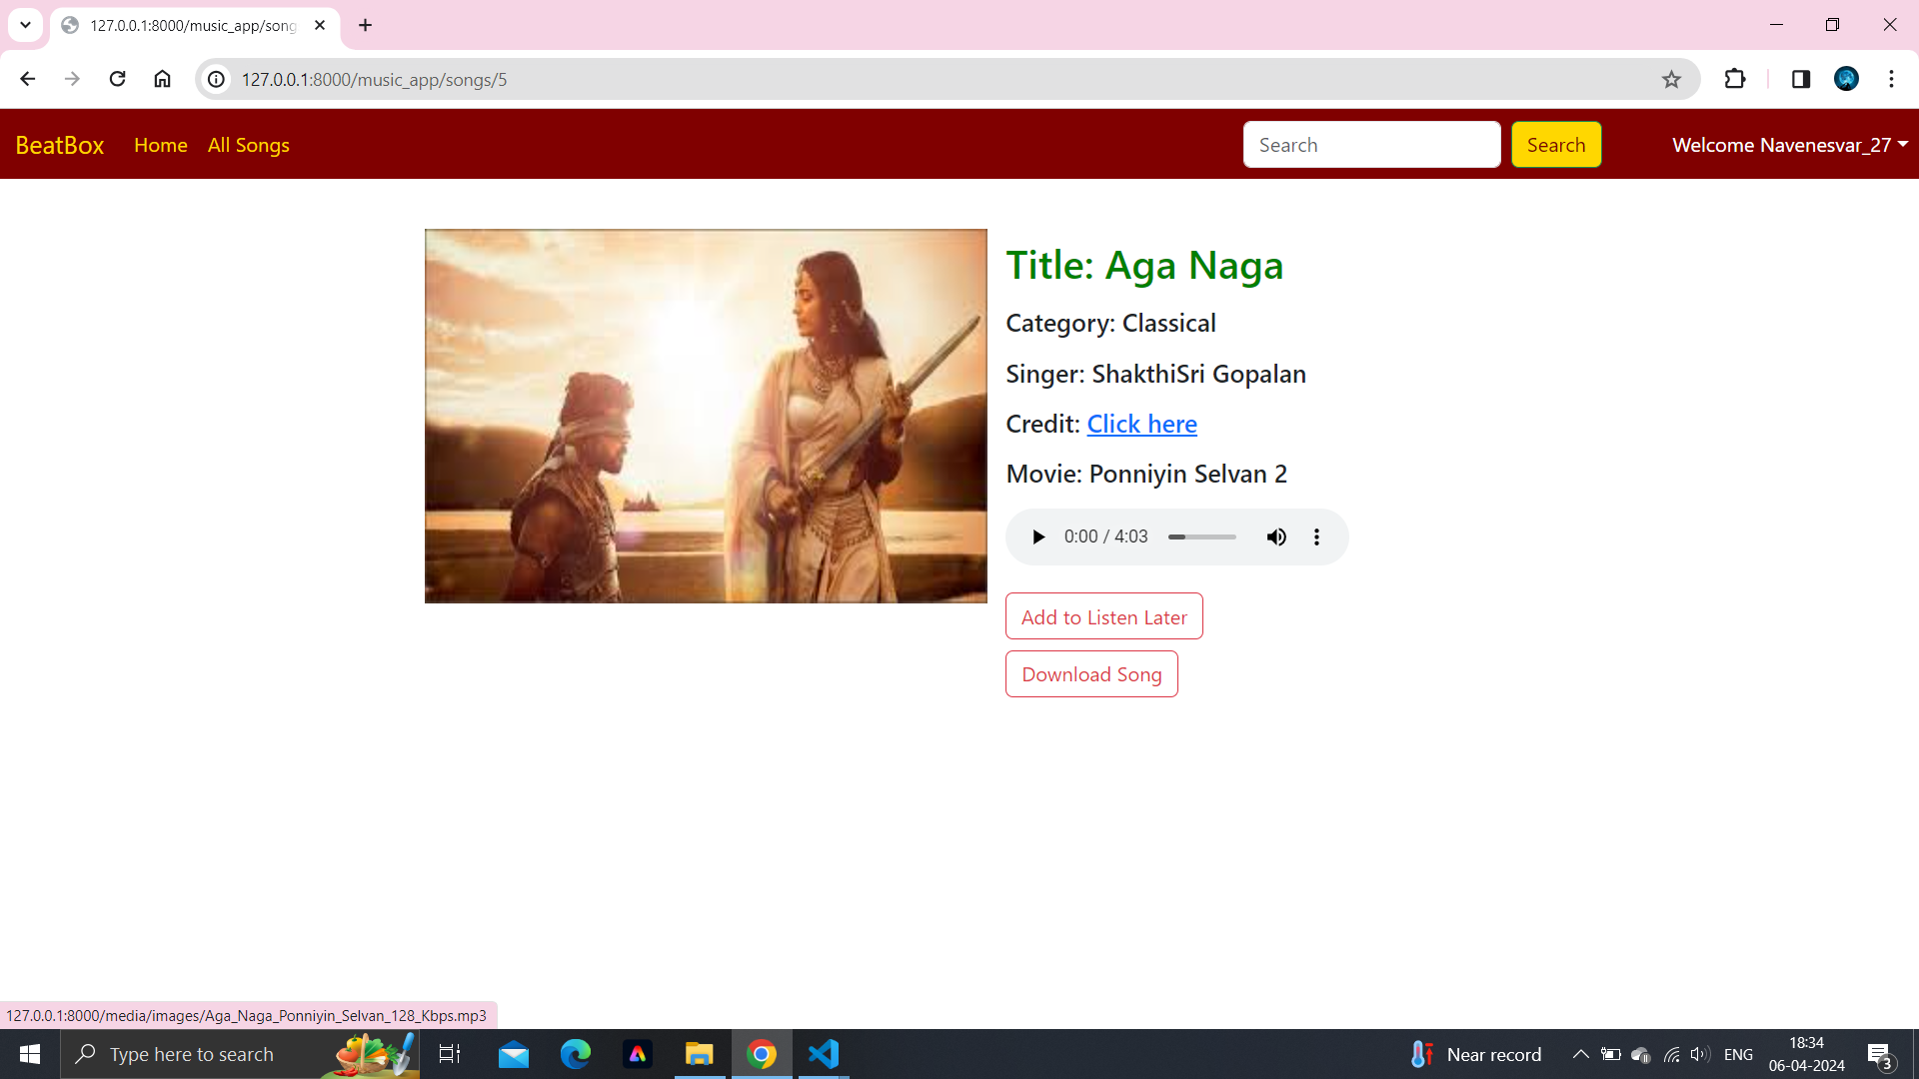
Next Gen Employability Program
Song Post Page : Details of each song will be displayed

Slide 20
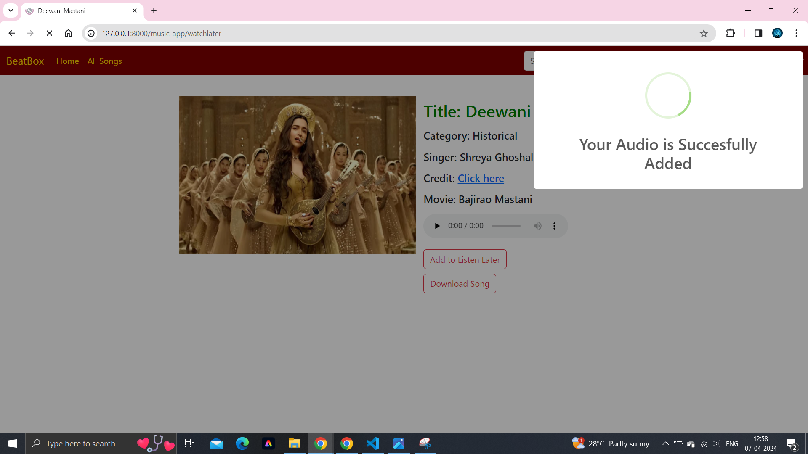
Next Gen Employability Program
Add to listen later

Slide 21
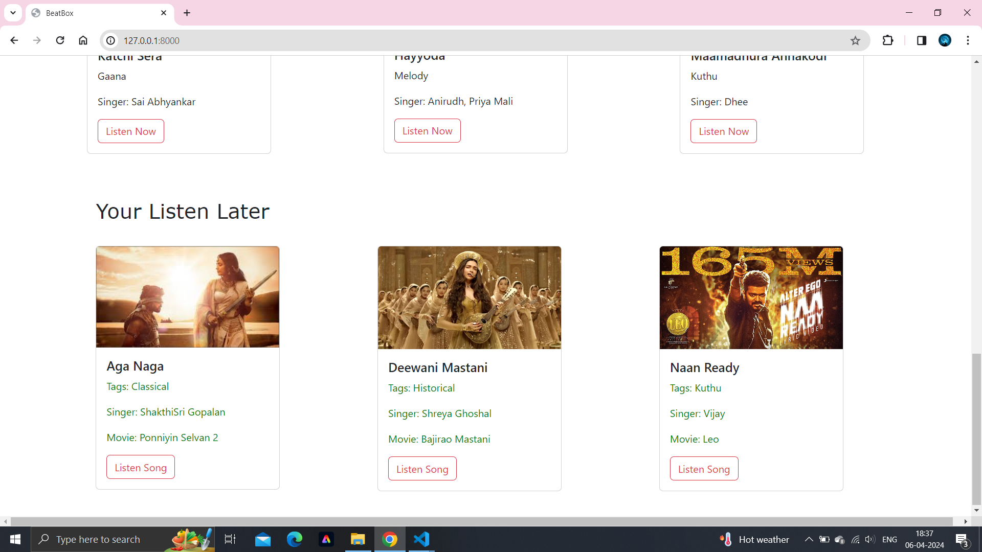
Next Gen Employability Program
Listen Later in the Homepage

Slide 22
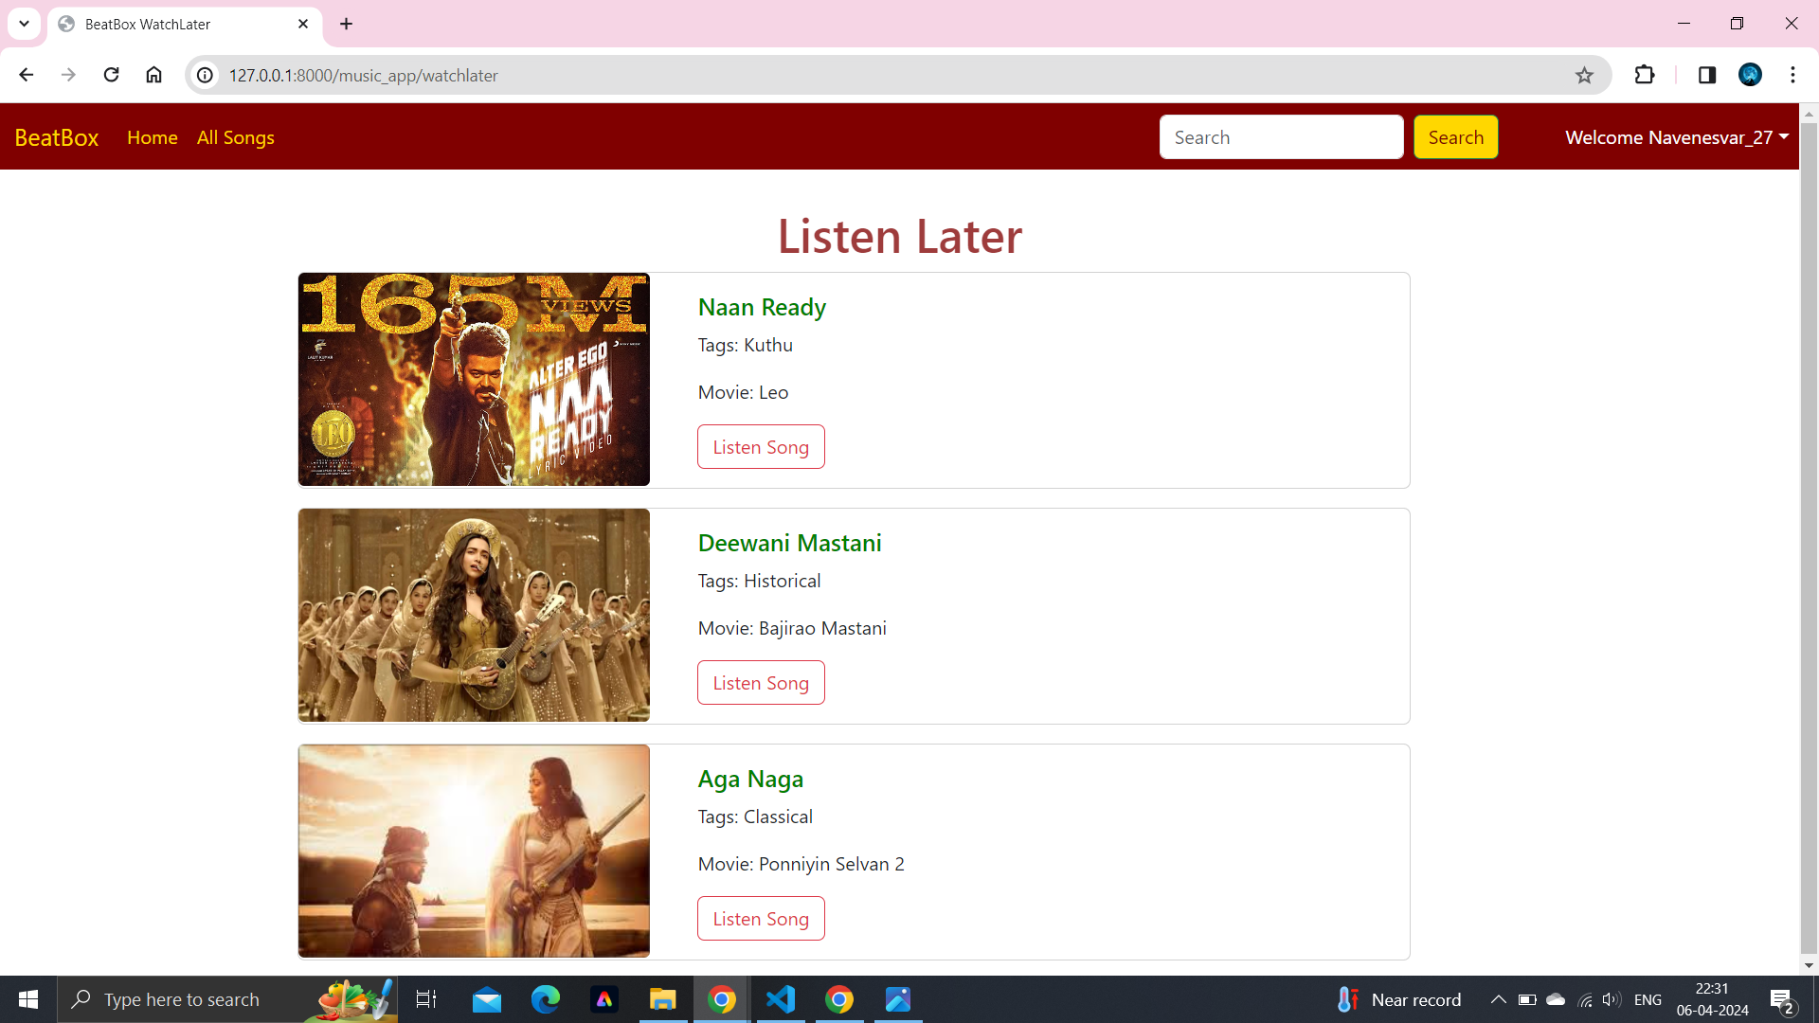
Next Gen Employability Program
Listen Later Page

Slide 23
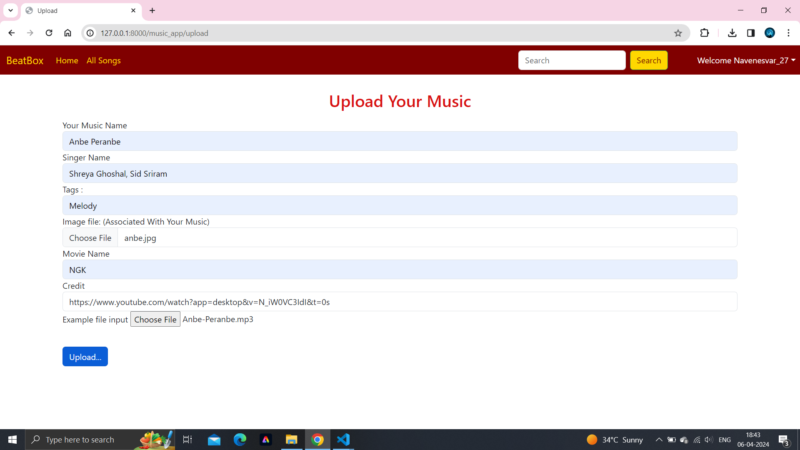
Next Gen Employability Program
Uploading music Page

Slide 24
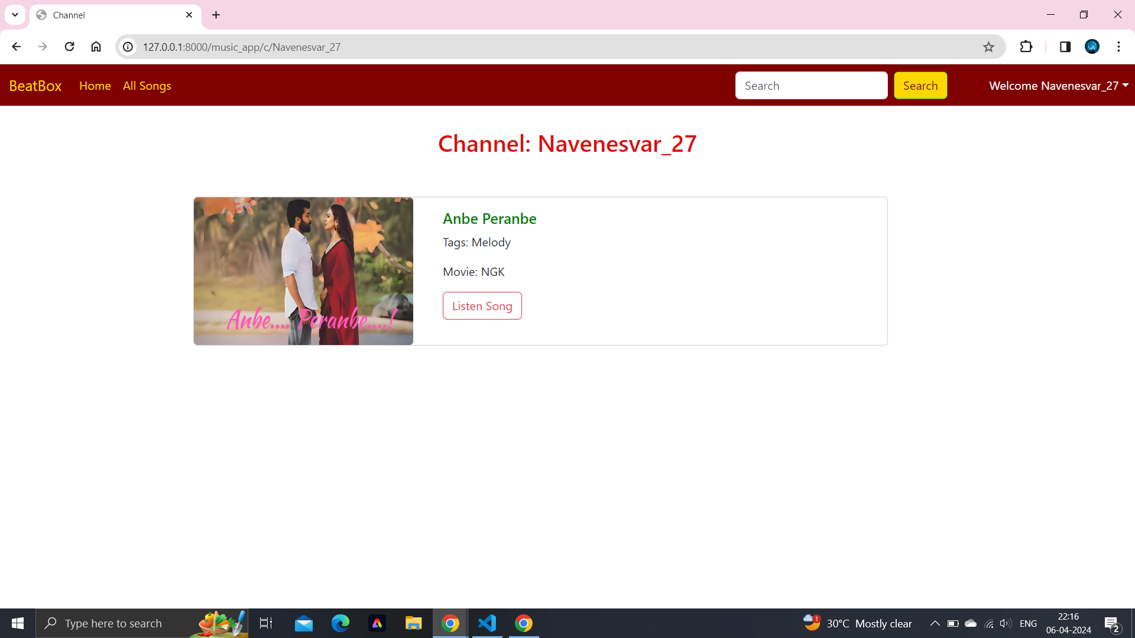
Next Gen Employability Program
My Channel Page after Uploading music

Slide 25
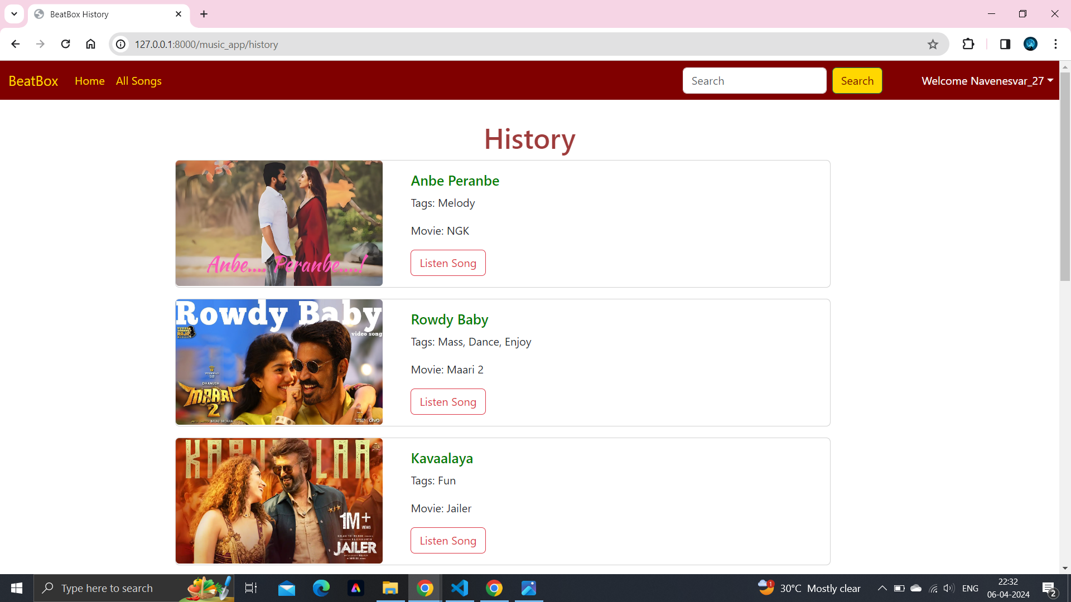
Next Gen Employability Program
Listen History Page

Slide 26
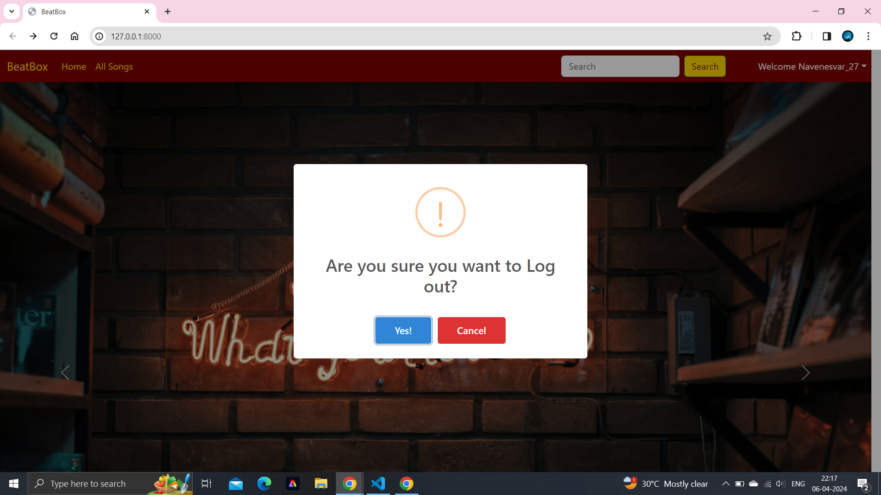
Next Gen Employability Program
Logout

Slide 27
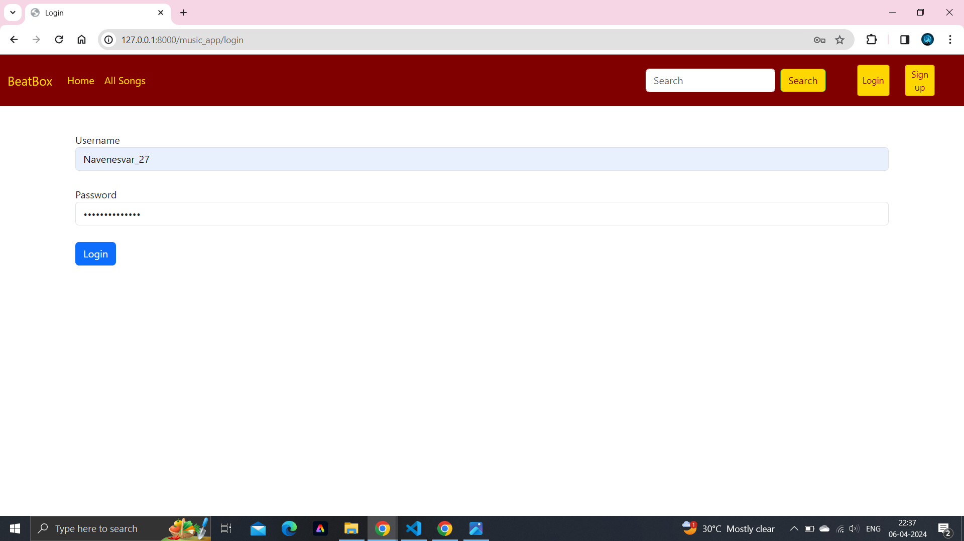
Next Gen Employability Program
Login after Logout

Slide 28
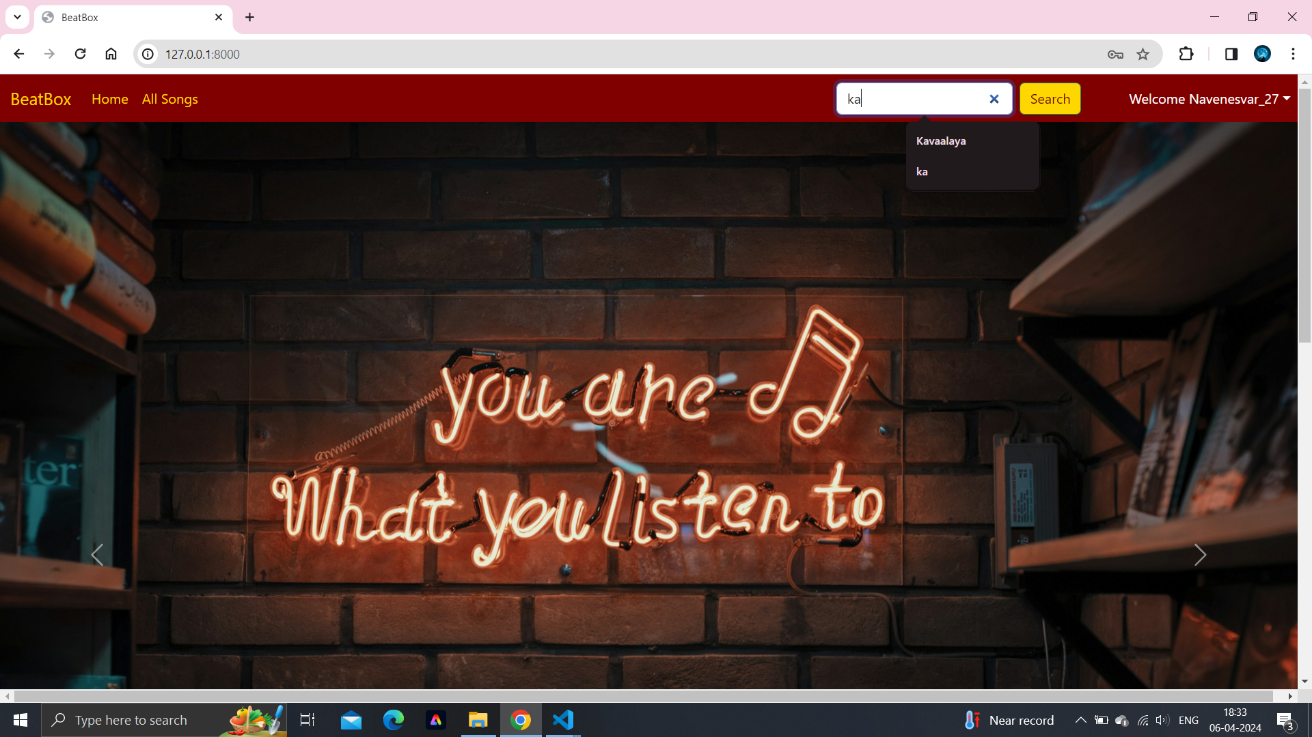
Next Gen Employability Program
Login successful: Welcome Page

Slide 29
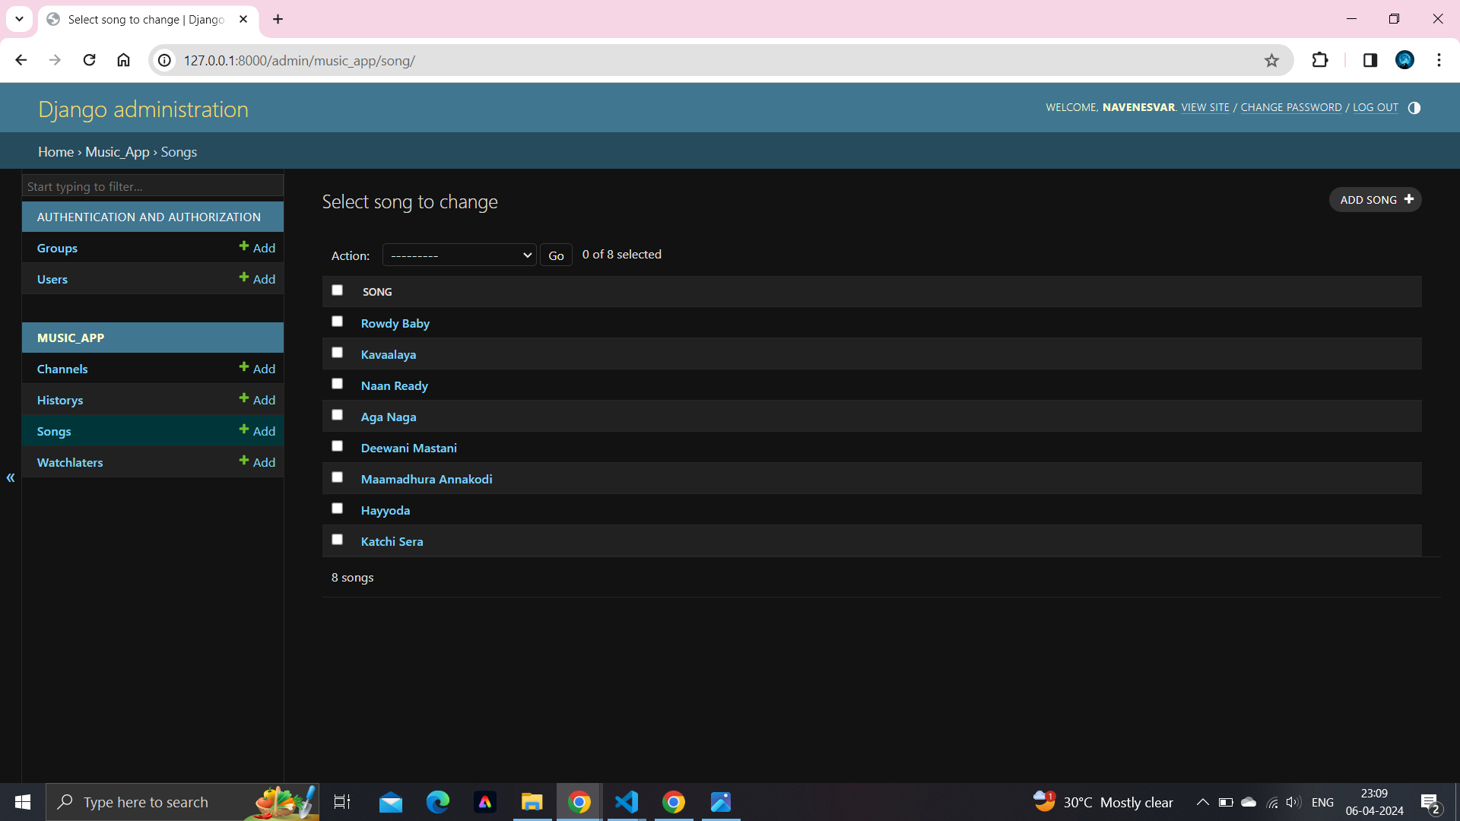
Next Gen Employability Program
Admin Dashboard (Username:Navenesvar , password: navenesvar)

Slide 30
Next Gen Employability Program
Future Enhancements:
Lyrics and Annotations: Display lyrics for songs in the application and allow users to contribute annotations, interpretations, and translations. This feature enhances the listening experience and fosters community engagement among users.
Keyword Filters: Allow users to enter keywords or phrases in the search bar to filter search results based on specific criteria. For example, users could enter keywords such as "rock," "pop," "artist name," "album title," or "genre" to narrow down search results to relevant content.
User Engagement: Incorporate interactive features including likes, comments, shares, views, and play counts to enhance user engagement. Users can express appreciation and share content,
Artist list: Implementing an "Artist List" feature within a music application could provide users with a convenient way to discover and explore music from their favorite artists play counts to enhance user engagement. Users can express appreciation and share content,

Slide 31
Next Gen Employability Program
Conclusion
The development of the music web application using Django has been a rewarding journey, equipping me with valuable skills and insights into full-stack web development. Through meticulous planning, implementation, and iteration, I have successfully created a robust platform that caters to the diverse needs of music enthusiasts.
Through the Naan Mudhalvan course "Full Stack Web Development Using Django" provided by Edunet Foundation under the Next Gen Employability Program, I have acquired comprehensive knowledge and practical skills in various web development technologies. These include HTML, CSS, JavaScript, PHP, MySQL, Python, and Django.
Throughout the course, I have gained hands-on experience in designing and implementing dynamic web applications, mastering the fundamentals of front-end and back-end development.

Slide 32
Next Gen Employability Program
Thank You!
Notes:
Thank You !!

